Slide 1






2025 SPARK ACADEMY
TRAIN FOR CHANGE, FROM SCIENCE TO PRACTICE
THE SPRINT AI TRAINING FOR AFRICAN MEDICAL
Imaging Knowledge Translation (SPARK)
Academy
IN DEEP LEARNING & MEDICAL IMAGING
Virtual Foundational Course Tutorial
Clinical Primer & Computing Basis
April 26th, 2025

Slide 2
Week 10: Weekend Tutorial
AGenda
Administrative Updates
Clinical Primer:
Preoperative Planning and Diagnosis and Staging
Computing Basics
Knowledge Distillation and Meta Learning
Medical Image Segmentation Using MedNeXt
Medical Image Segmentation Using nnUnet
Medical Image Super-Resolution Using Diffusion Model
General Q & A
Week 10 Assignment
https://event.fourwaves.com/spark

Slide 3
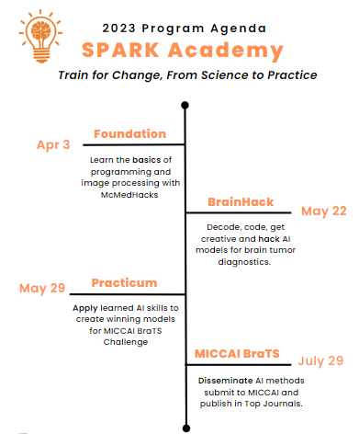
SPARK Program Overview
Program Objective
Build an interdisciplinary network of AI experts in medical imaging across Africa
Provide transferable research skills in study design, execution, and dissemination including publications and science communication
Create a collaborative culture of developing innovative medical solutions across Africa
Contribute to the open science efforts of the global AI imaging community
Train and retain experts to advance medical research across Africa.
Win Medical or Health Care Grand Challenges!!!
Feb 22
May 12
May 24
Aug 9
https://event.fourwaves.com/spark

Slide 4
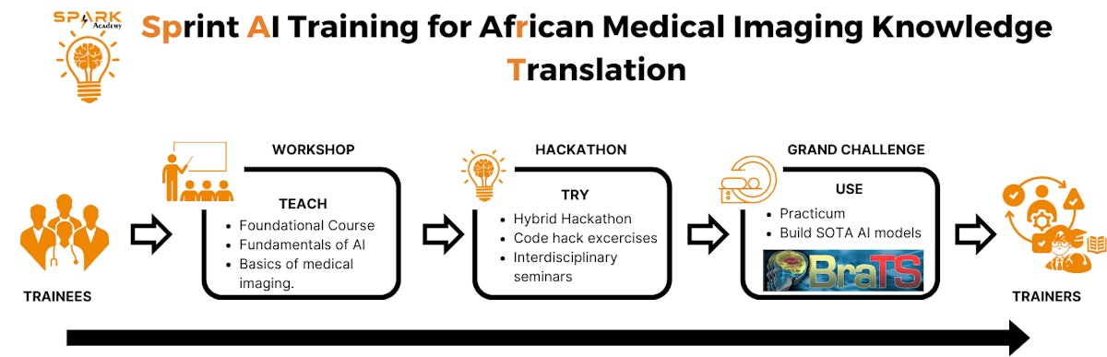
SPARK Program Overview
Feb 22
May 12
May 24
Ongoing
12-16th May
22nd May – 9th August
Aug 9
https://event.fourwaves.com/spark

Slide 5
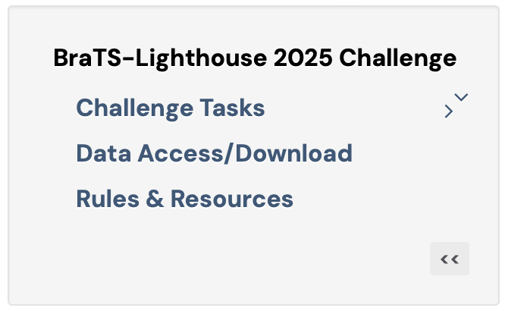
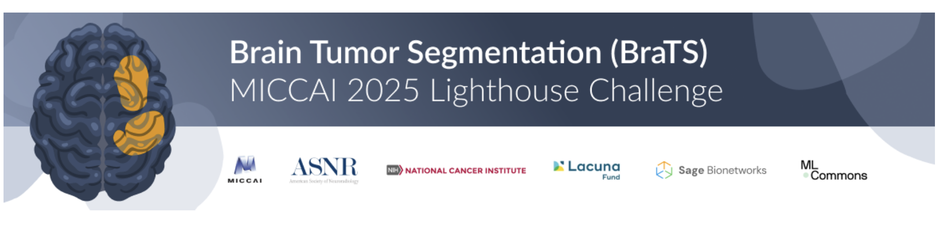
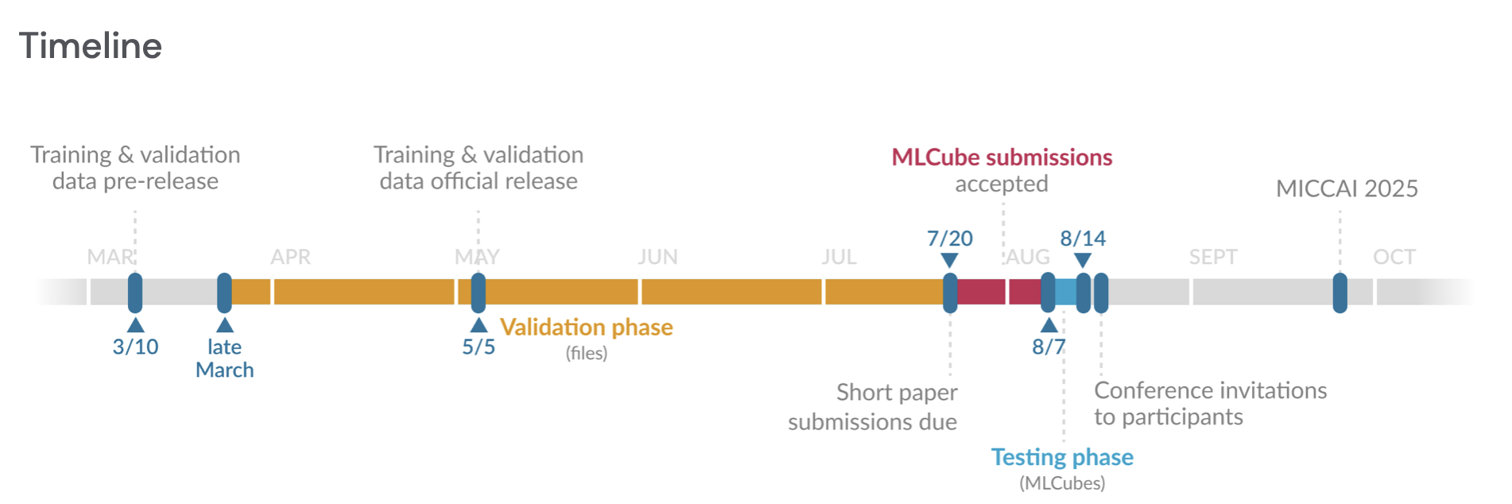
SPARK Practicum - MICCAI BraTS Challenge
https://event.fourwaves.com/spark

Slide 6
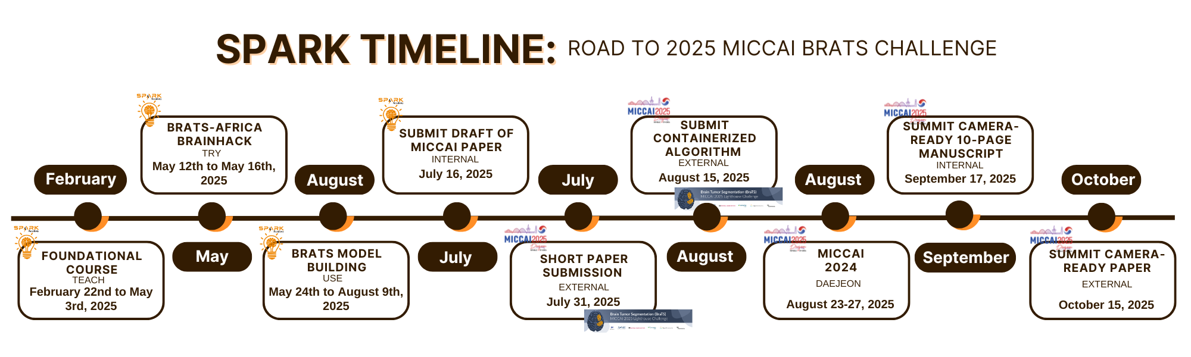
SPARK Practicum - MICCAI BraTS Challenge
FORMAT:
Foundation (Teach): Feb 22nd to May 3rd
Virtual + 3hr Midweek Meeting
+ 2hr Saturday Tutorial
Hackathon (Try): May 12th to May 16th
Hybrid + 9hr Monday to Friday
Practicum (Use): May 24th to August 3th
Virtual + 3hr Midweek Meeting
+ 2hr Saturday Tutorial
All live events including seminars and tutorials are in East Africa Time
https://event.fourwaves.com/spark

Slide 7





Collaborative Learning
Program Objective
Interdisciplinary Collaboration
Innovation In Medical Solutions
Collaborative Culture
Win Health Grand Challenges!
Approach
Collective
Intelligence
Trained As A
Team
Every member of the team brings their expertise
Complete courses, Hackathon, Practicum (conference papers)
https://event.fourwaves.com/spark

Slide 8
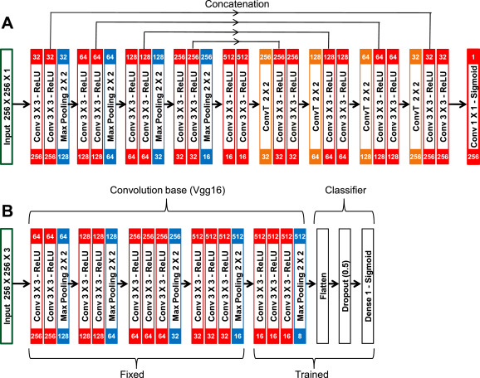
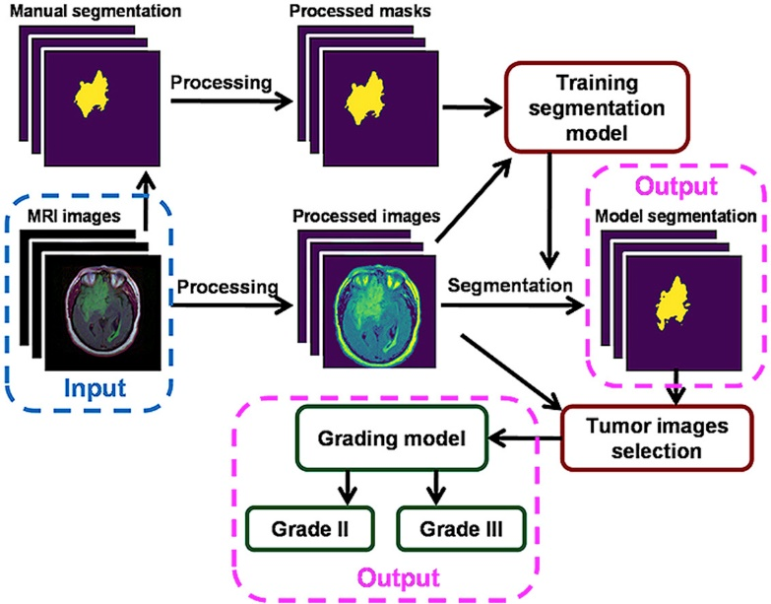

Multi-disciplinary Team
AI WORKFLOW FOR BRAIN TUMOR SEGMENTATION AND GRADING
Manual Segmentation (Ground truth)
Expert label or annotation (Clinicians)
Neuroradiologist (expert reader)
Neurooncologist
Neurosurgeon
Neuropathologist/Anatomist
Model development
Skilled Computational Scientists
Computer scientist
Physicists (medical image processing)
Neuroradiologist
Neurosurgeon
Neurooncologist
Input Data
Interoperable Data Collection
Radiographer (high value data acquisition)
Neuroradiologist (protocolling)
Physicists (image sequence and techniques)
IT & Informatics / Data Engr (Archive Storage)
Collective
Intelligence
https://event.fourwaves.com/spark

Slide 9

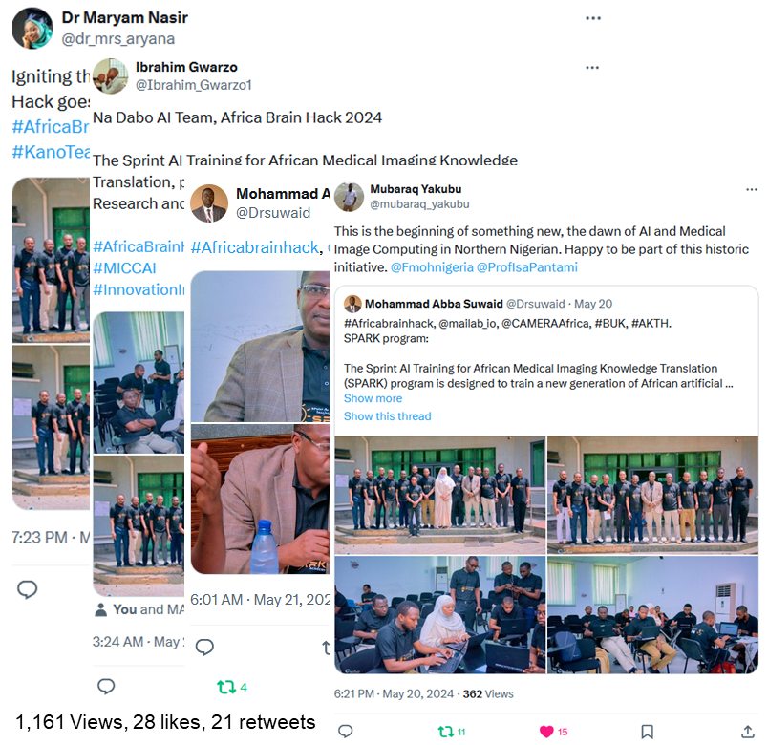




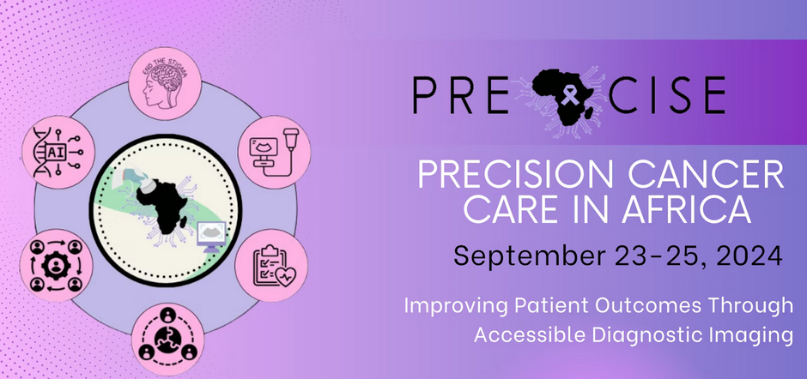
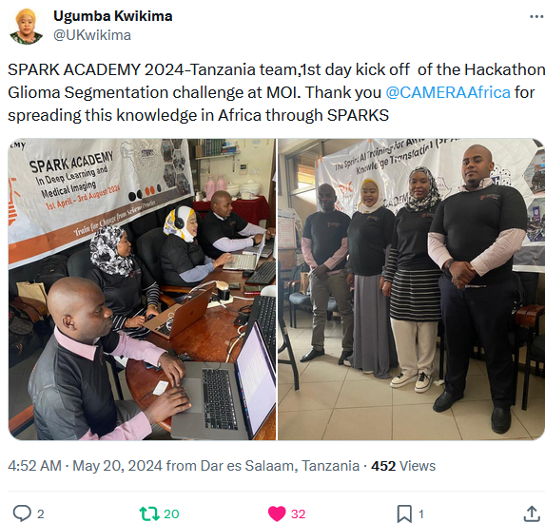

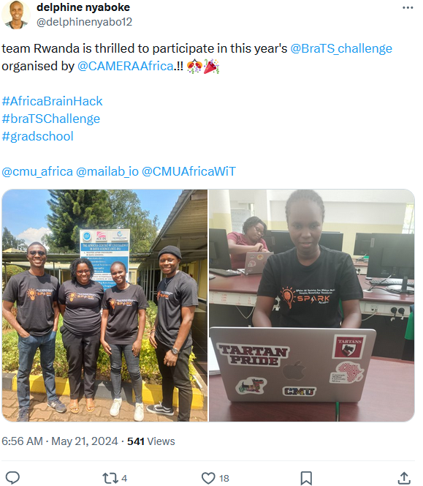


SPARK Academy Awards
Hackathon Participation Award
$1000
Academy Participation Award
$33,000
1Yr- MSE-DS Scholarship
$70,000+
1 Team ($700)
20 Individuals ($1650/person)
2 Individuals ($35,000 per person)
Team Na Dabo AI
Satellite Registration Fee
Flight
Accommodations
13+ Individuals ($300)
https://event.fourwaves.com/spark

Slide 10












2025 PROGRAM AGENDA
Train the trainer strategy
Train for Change, From Science to Practice
OCTOBER 15
FEBRUARY 22
MAY 24
GO
TEACH
MAY 12
USE
AUGUST 9
Need Assessment
Identify Knowledge gaps
Apply Acquired skills to local problems
Foundational Course
Fundamentals of AI
and medical imaging.
TRY
Practicum
Build SOTA AI models
Scientific communication
Participate in a grand Challenge
FROM TRAINEES TO
TRAINERS
Hybrid Hackathon
Code hack exercises
Interdisciplinary seminars
Transform trainees to trainers

Slide 11
2025 PROGRAM AGENDA
Train the trainer strategy
Train for Change, From Science to Practice
OCTOBER 15
FEBRUARY 22
MAY 24
GO
TEACH
MAY 12
USE
AUGUST 9
Need Assessment
Identify Knowledge gaps
Apply Acquired skills to local problems
Foundational Course
Fundamentals of AI
and medical imaging.
TRY
Practicum
Build SOTA AI models
Scientific communication
Participate in a grand Challenge
FROM TRAINEES TO
TRAINERS
Hybrid Hackathon
Code hack exercises
Interdisciplinary seminars
Transform trainees to trainers

Slide 12













The Sprint AI Training for African Medical Imaging Knowledge Translation
12
DAY 1
PROJECT PLANNING AND DATA ACQUISITION
SPARK ACADEMY
Submit a summary of the model paper outlining
BraTS-AFRICA
BrainHack 2025
15
12 - 16th May 2025
DAY 4
MODEL TRAINING, VALIDATION AND EVALUATION
14
Identify model deficiencies & outline strategies to address them.
Report Performance
DAY 3
MODEL SELECTION AND TRAINING
Report Initial or preliminary results from model training
13
DAY 2
16
DAY 5
DATA EXPLORATION AND PREPROCESSING
MODEL EVALUATION AND OPTIMIZATION
Outline any challenges faced in implementing preprocessing
Prepare their 5-Minute Capstone Presentation
Train for Change, from Science to Practice

Slide 13
2025 Brainhack UTC+5:45 Agenda
 | Monday 12 | Tuesday 13 | Wednesday 14 | Thursday 15 | Friday 16
10:15 am Morning Coffee
10:15 – 11:45 am AM Seminar | Intro to Africa-Brats Challenge and Dataset | Neurosurgery of Gliomas | Code Hack | Imaging Brain Tumors in Africa | How to Write MICCAI Papers
11:45 – 12:45 pm DeCode | Evolution of Medical Imaging - (MRI, PET, DTI, Imaging guiding surgery in gliomas) -US insight preoperative for gliomas resection | Code Hack | Neurosurgery of Gliomas | Code Hack
 |  |  | Code Hack
12:45 – 01:45 pm DeCode | Intro to BraTS
01:45 - 02:45 pm Lunch Break
02:45 – 4:45 pm Ubuntu | Team Exercise, Recode Program evaluation | Team Exercise, Recode | Team Exercise, Recode | Team Exercise, Recode | Team Exercise, Recode
5:15 pm Afternoon Tea | Team Photos
5:15 – 6:15 pm PM Seminar | Image processing and analysis of Brain Tumors | Neuropathology of Gliomas | Imaging Physics and Radiobiology of Gliomas | Big Data, FAIR & Open Science | Capstone Project Presentations
6:15 – 7:15pm Umoja | Live Coding with BraTS 2024 Authors | State of AI in Brain Tumor | Low-cost Clinical Deployment | Bioinformatics & Radiomics of early detection
7:15pm | Adjourn |  |  |  | Closing Plenary
8:15 pm |  |  |  |  | Team Photos Group Dinner
Time Zones
Nepal Time (UTC+5:45)
Nepal

Slide 14
2025 Brainhack UTC+3 Agenda
 | Monday 12 | Tuesday 13 | Wednesday 14 | Thursday 15 | Friday 16
7:30 am Morning Coffee
8:00 – 9:00am AM Seminar | Intro to Africa-Brats Challenge and Dataset | Neurosurgery of Gliomas | Code Hack | Imaging Brain Tumors in Africa | How to Write MICCAI Papers
9:00 – 10:00am DeCode | Evolution of Medical Imaging - (MRI, PET, DTI, Imaging guiding surgery in gliomas) -US insight preoperative for gliomas resection | Code Hack | Neurosurgery of Gliomas | Code Hack
 |  |  | Code Hack
10:00 – 11:00 am DeCode | Intro to BraTS
11:00 -12:00 pm Lunch Break
12:00 – 2:00pm Ubuntu | Team Exercise, Recode Program evaluation | Team Exercise, Recode | Team Exercise, Recode | Team Exercise, Recode | Team Exercise, Recode
2:30 pm Afternoon Tea | Team Photos
2:30 – 3:30pm PM Seminar | Image processing and analysis of Brain Tumors | Neuropathology of Gliomas | Imaging Physics and Radiobiology of Gliomas | Big Data, FAIR & Open Science | Capstone Project Presentations
3:30 – 4:30pm Umoja | Live Coding with BraTS 2024 Authors | State of AI in Brain Tumor | Low-cost Clinical Deployment | Bioinformatics & Radiomics of early detection
4:30pm | Adjourn |  |  |  | Closing Plenary
5:30pm |  |  |  |  | Team Photos Group Dinner
Time Zones
East Africa Time (EAT, UTC+3)
Tanzania -Serengeti
Rwanda-Limitless
Ethiopia-Adwa
Uganda-Pearl AI
Kenya-Afyaspark_ke

Slide 15
2025 Brainhack UTC+2 Agenda
 | Monday 12 | Tuesday 13 | Wednesday 14 | Thursday 15 | Friday 16
7:30 am Morning Coffee
8:00 – 9:00am AM Seminar | Intro to Africa-Brats Challenge and Dataset | Neurosurgery of Gliomas | Code Hack | Imaging Brain Tumors in Africa | How to Write MICCAI Papers
9:00 – 10:00am DeCode | Evolution of Medical Imaging - (MRI, PET, DTI, Imaging guiding surgery in gliomas) -US insight preoperative for gliomas resection | Code Hack | Neurosurgery of Gliomas | Code Hack
 |  |  | Code Hack
10:00 – 11:00 am DeCode | Intro to BraTS
11:00 -12:00 pm Lunch Break
12:00 – 2:00pm Ubuntu | Team Exercise, Recode Program evaluation | Team Exercise, Recode | Team Exercise, Recode | Team Exercise, Recode | Team Exercise, Recode
2:30 pm Afternoon Tea | Team Photos
2:30 – 3:30pm PM Seminar | Live Coding with BraTS 2024 Authors | State of AI in Brain Tumor | Low-cost Clinical Deployment | Bioinformatics & Radiomics of early detection | Capstone Project Presentations
3:30 – 4:30pm Umoja | Image processing and analysis of Brain Tumors | Neuropathology of Gliomas | Imaging Physics and Radiobiology of Gliomas | Big Data, FAIR & Open Science
4:30pm | Adjourn |  |  |  | Closing Plenary
5:30pm |  |  |  |  | Team Photos Group Dinner
Time Zones
East Africa Time (EAT, UTC+2)
Botswana-Ai MedVisionaries
South Africa-Sparkans

Slide 16
2025 Brainhack UTC+1 Agenda
 | Monday 12 | Tuesday 13 | Wednesday 14 | Thursday 15 | Friday 16
7:30 am Morning Coffee
8:00 – 9:00am AM Seminar | Intro to Africa-Brats Challenge and Dataset | Neurosurgery of Gliomas | Code Hack | Imaging Brain Tumors in Africa | How to Write MICCAI Papers
9:00 – 10:00am DeCode | Evolution of Medical Imaging - (MRI, PET, DTI, Imaging guiding surgery in gliomas) -US insight preoperative for gliomas resection | Code Hack | Neurosurgery of Gliomas | Code Hack
 |  |  | Code Hack
10:00 – 11:00 am DeCode | Intro to BraTS
11:00 -12:00 pm Lunch Break
12:00 – 12:30pm Ubuntu I | Team Exercise, Recode Program evaluation | Team Exercise, Recode | Team Exercise, Recode | Team Exercise, Recode | Team Exercise, Recode
12:30 – 1:30pm PM Seminar | Image processing and analysis of Brain Tumors | Neuropathology of Gliomas | Imaging Physics and Radiobiology of Gliomas | Big Data, FAIR & Open Science
1:30 – 2:30pm Umoja | Live Coding with BraTS 2024 Authors | State of AI in Brain Tumor | Low-cost Clinical Deployment | Bioinformatics & Radiomics of early detection
2:30 – 3:00 pm Afternoon Tea | Team Photos
03:00 – 4:30pm Ubuntu II | Team Exercise, Recode | Team Exercise, Recode | Team Exercise, Recode | Team Exercise, Recode | Capstone Project Presentations
4:30pm | Adjourn |  |  |  | Closing Plenary
5:30pm |  |  |  |  | Team Photos Group Dinner
Time Zones
East Africa Time (EAT, UTC+1)
Nigeria (Kano, Abuja, North East, Lagos I, Lagos II, Lagos III, South West, South South, North Central, East, Oyo, Minna)
Algeria-AIFennecs

Slide 17
2025 Brainhack UTCAgenda
 | Monday 12 | Tuesday 13 | Wednesday 14 | Thursday 15 | Friday 16
7:30 am Morning Coffee
8:00 – 9:00am AM Seminar | Intro to Africa-Brats Challenge and Dataset | Neurosurgery of Gliomas | Code Hack | Imaging Brain Tumors in Africa | How to Write MICCAI Papers
9:00 – 10:00am DeCode | Evolution of Medical Imaging - (MRI, PET, DTI, Imaging guiding surgery in gliomas) -US insight preoperative for gliomas resection | Code Hack | Neurosurgery of Gliomas | Code Hack
 |  |  | Code Hack
10:00 – 11:00 am DeCode | Intro to BraTS
11:00 -11:30 pm Lunch Break
11:30 – 12:30pm PM Seminar | Image processing and analysis of Brain Tumors | Neuropathology of Gliomas | Imaging Physics and Radiobiology of Gliomas | Big Data, FAIR & Open Science | Team Exercise, Recode
12:30 – 1:30pm Umoja | Live Coding with BraTS 2024 Authors | State of AI in Brain Tumor | Low-cost Clinical Deployment | Bioinformatics & Radiomics of early detection
1:30 – 3:00 pm Afternoon Tea | Team Photos
03:00 – 4:30pm Ubuntu II | Team Exercise, Recode Program evaluation | Team Exercise, Recode | Team Exercise, Recode | Team Exercise, Recode | Capstone Project Presentations
4:30pm | Adjourn |  |  |  | Closing Plenary
5:30pm |  |  |  |  | Team Photos Group Dinner
Time Zones
East Africa Time (EAT, UTC)
Ghana (Kumasi, Tamale, Accra)
Morocco
Senegal (Senegal I, Senegal II)
Team French

Slide 18
Hackathon Mode
SN | Team Name | Brain Hack Mode
1 | Botswana-Ai MedVisionaries | Onsite
2 | Arabic-GrokBrain | Online
3 | Algeria-AIFennecs | Online
4 | Nepal-Team Saipal | Onsite
5 | Uganda-Pearl AI | Onsite
6 | Ethiopia-Adwa | Online
7 | Tanzania-Serengeti | Onsite
8 | Morocco | Online
9 | Diaspora-Diaspora | Online
10 | Team Wakanda | Online
11 | Kenya-Afyaspark_ke | Online
12 | Rwanda-Limitless | Online
13 | Senegal I-Teranga | Onsite
14 | Senegal II-Jolof Health AI | Onsite
15 | Ghana Kumasi-Neuro-Ashanti | Online
SN | Team Name | Brain Hack Mode
16 | Ghana Tamale-Baobab | Onsite
17 | Team French | Online
18 | Lagos 1-Lag1 | Onsite
19 | Lagos II-Team AfirikAI | Onsite
20 | Lagos III-SynaptiQ | Onsite
21 | Nigeria North East-Savanah AI | Online
22 | Nigeria Oyo-Oyo | Onsite*
23 | Kano-Tumbin Giwa | Onsite
24 | Nigeria South East-Ògànírú | Online
25 | Nigeria South South | Online
26 | Abuja-HaskeAI | Online
27 | Team Minna | Onsite
28 | Nigeria North Central | Online
29 | South Africa -Sparkans | Online
30 | Nigeria South South | Online

Slide 19
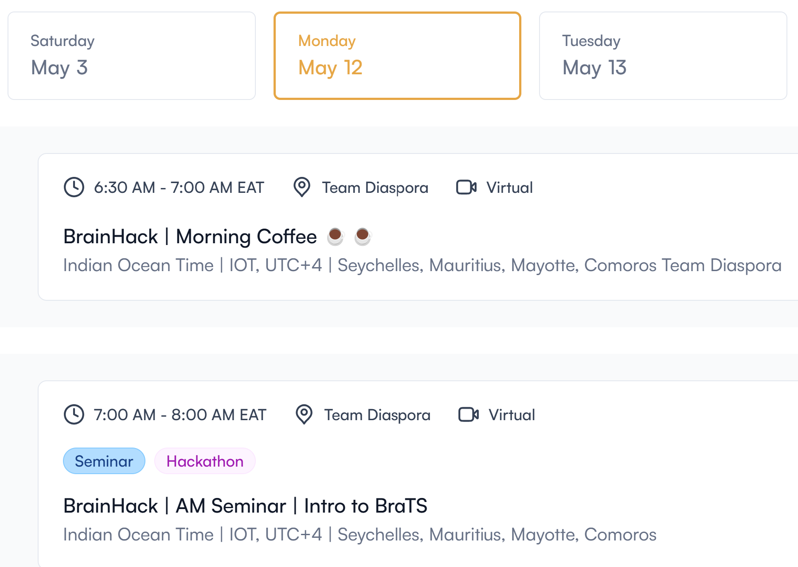
The Sprint AI Training for African Medical Imaging Knowledge Translation
SPARK ACADEMY
BraTS-AFRICA
BrainHack 2025
Attendance !!!
100% attendance is required
Always Login with your full name and email address used during registrations!!
12 - 16th May 2025
Seminars and Presentations are on Fourwaves
Team meetings are either in person or virtual
Train for Change, from Science to Practice
https://event.fourwaves.com/spark

Slide 20
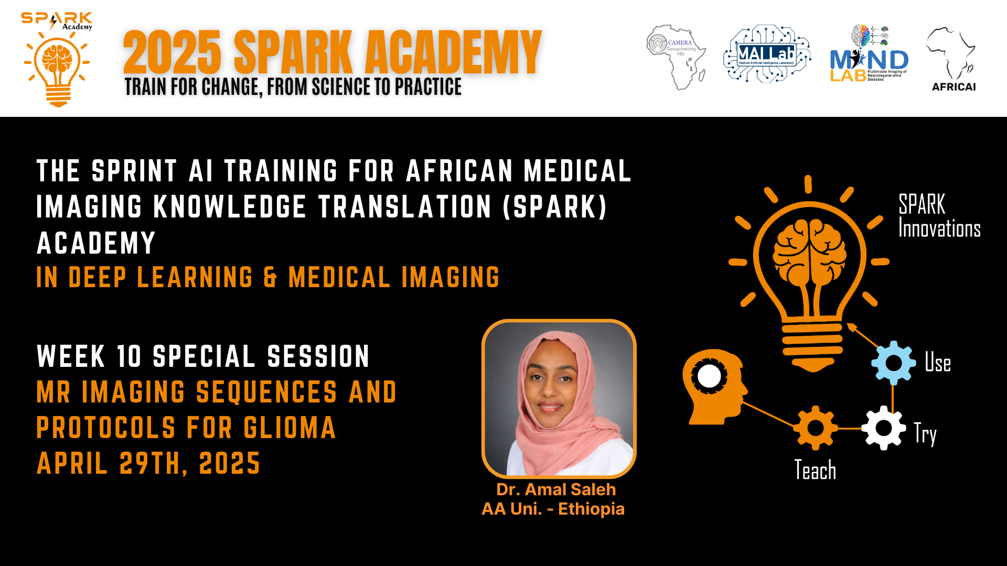
Mark Your Calendar
Special Clinical and Imaging Session
Live on Fourwaves

Slide 21


Computing Resources
High-Performance Computing Training
Programmers/ Team Captains/Team Coordinators
Date and time to be announced shortly!!
Cloud Computing
https://event.fourwaves.com/spark

Slide 22
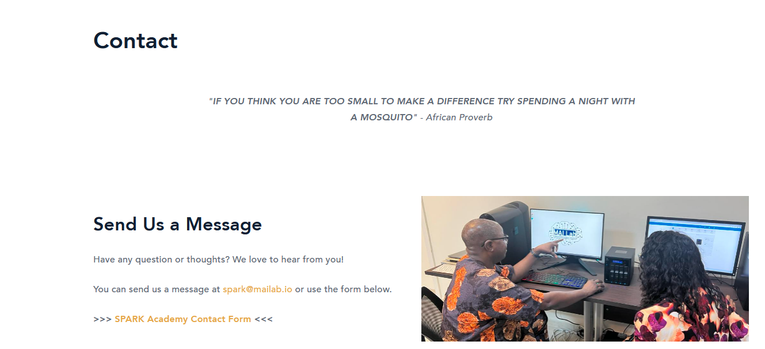
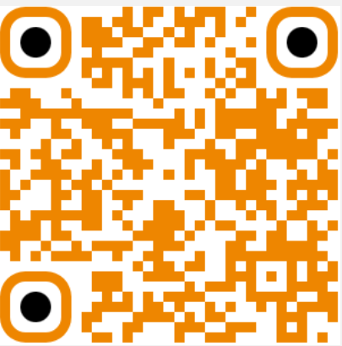
FAQ and Contact Information
Contact
For general program information, consult the FAQ section of the training platform in Fourwaves.
For general program inquiry, contact the SPARK Academy team at spark@mailab.io.
For project specific information or questions related to your team assignment, hackathon project or team’s BraTS project, contact your Team Supervisor.
For all other program related inquiries, contact the SPARK Academy team at spark@mailab.io
Socials: Follow us for up-to-date
program information
https://event.fourwaves.com/spark

